Slide 1
You Need A Budget Provider
Participants:
Vaibhav Singal

Slide 2
You Need A Budget (YNAB)
What is webMethods CloudStreams Provider for YNAB?
You Need a Budget, or YNAB, is a popular paid budgeting app. While some budgeting apps only show people what they've already spent, You Need a Budget focuses on zero-based budgeting. The app teaches you to put all your money to use -- including using your money for expenses, paying off debt, and saving extra money.
YNAB offers an API which is REST based, uses the JSON data format and is secured with HTTPS. You can use it to build a personal application to interact with your own budget or build an application that any other YNABer can authorize and use. API resources require a valid access token for authentication. There are two ways to obtain access tokens: Personal Access Tokens and OAuth Applications.

Slide 3
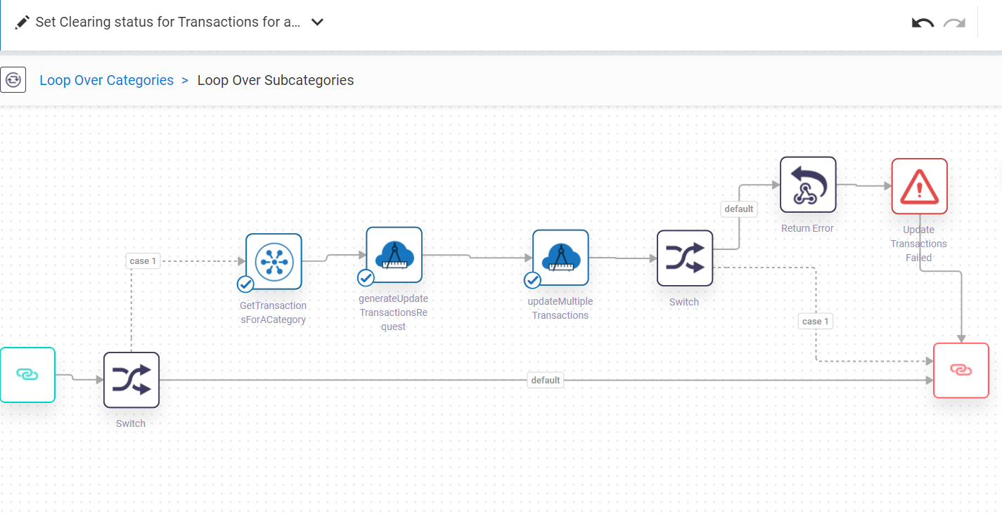
Screenshots for workflow

